Slide 1



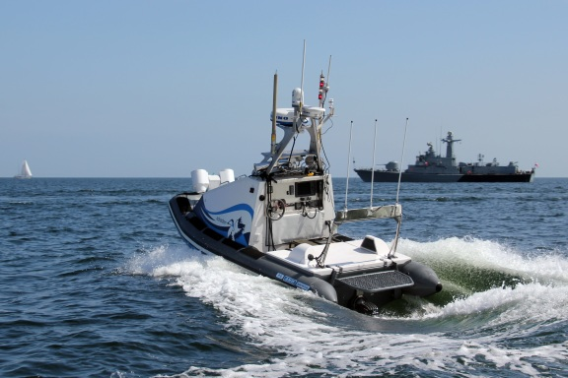
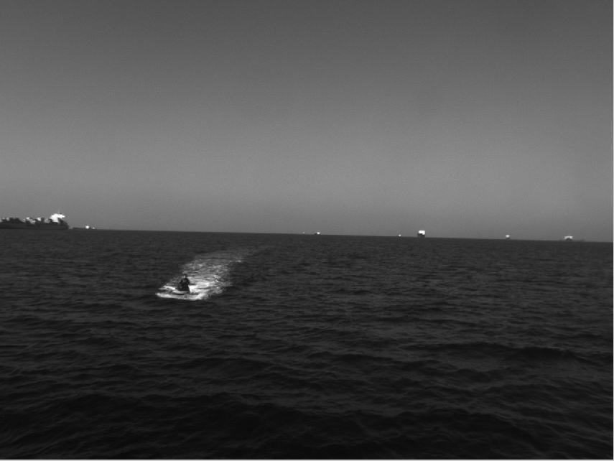
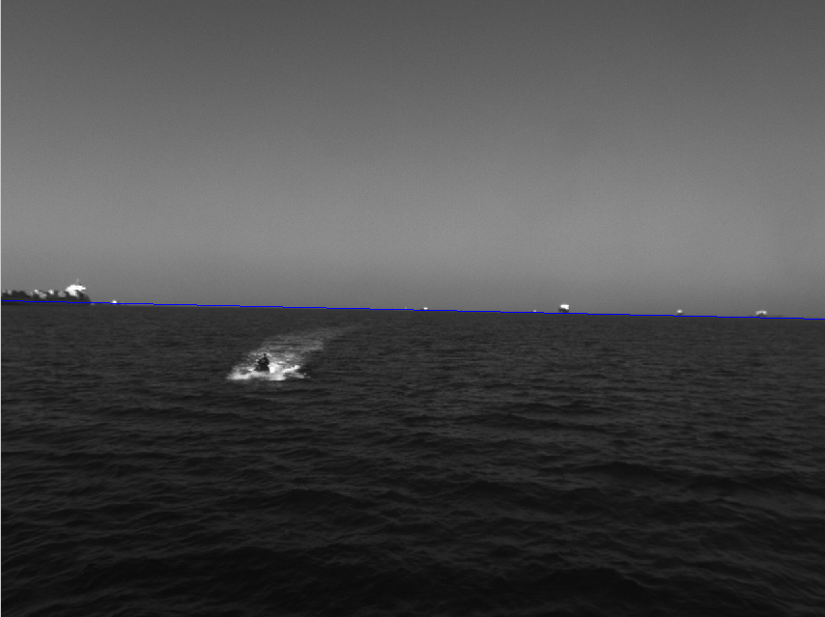
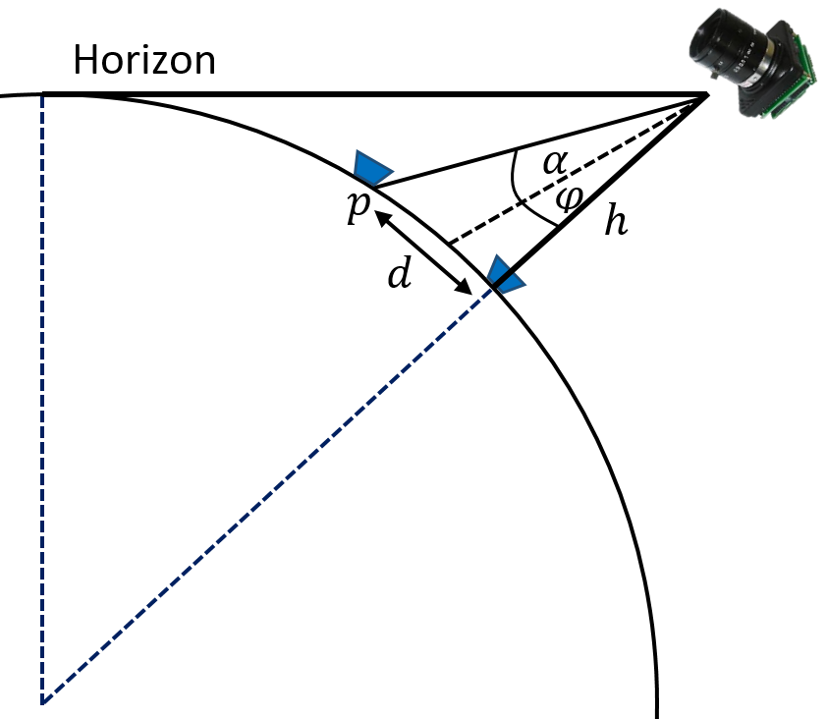
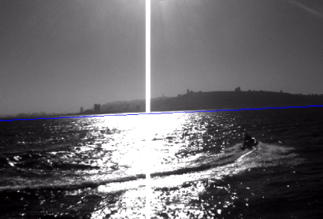
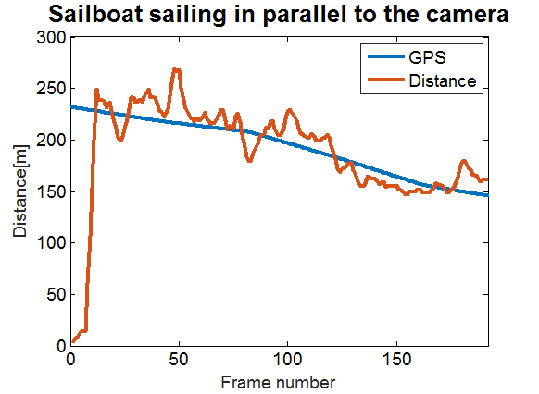
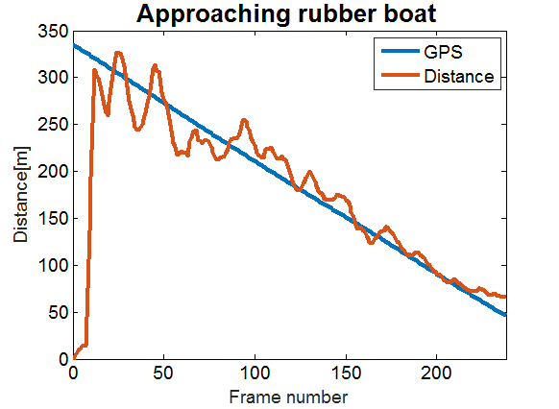
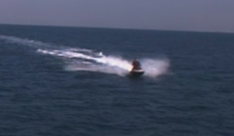
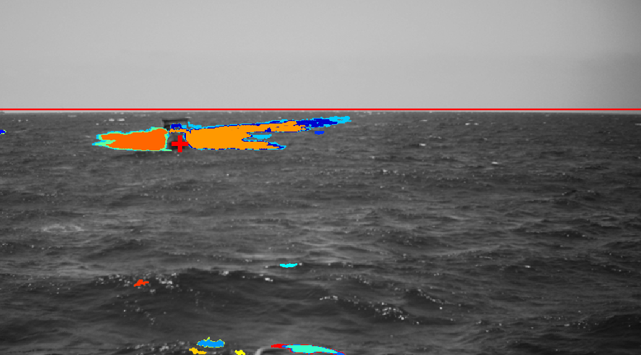
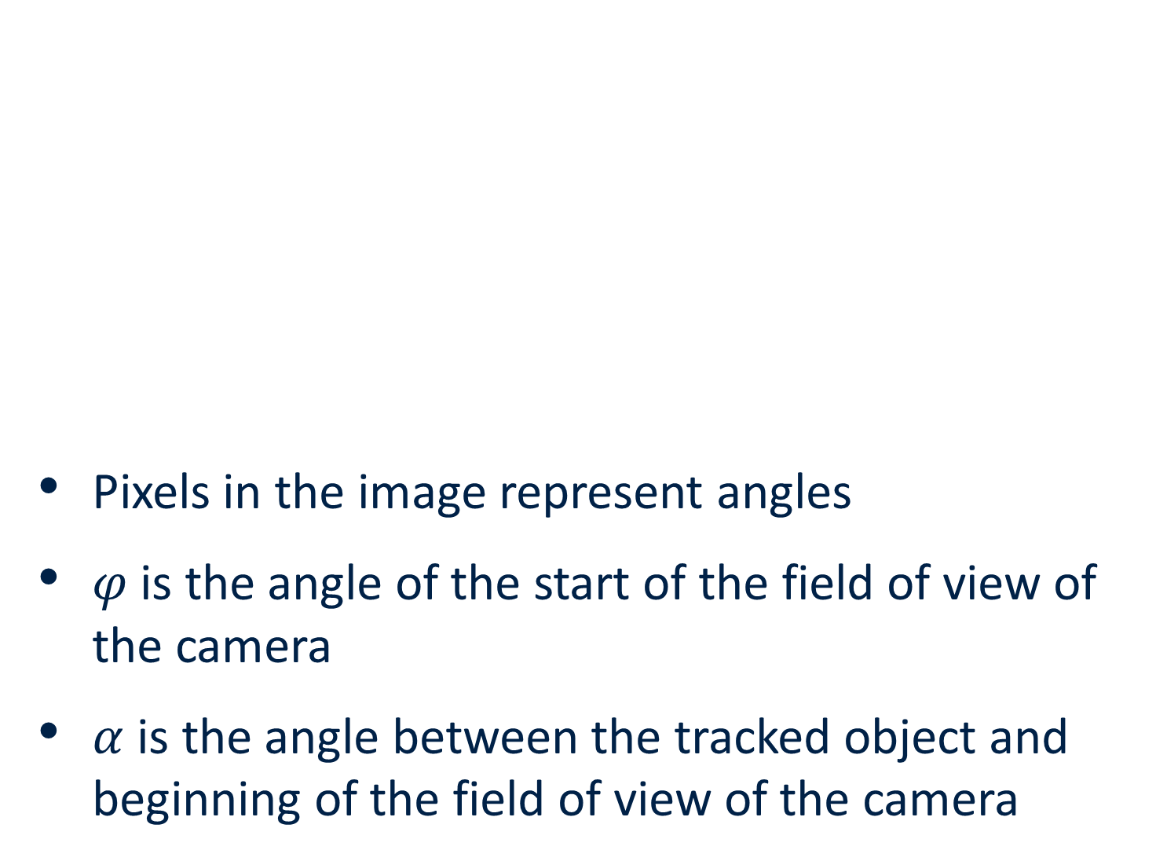



Distance Estimation of Marine Vehicles
Ran Gladstone and Avihai Barel, Supervised by Yair Moshe
Introduction
Horizon Detection
Distance to Horizon
Unmanned ship vehicles (USVs) are vehicles that operate on the surface of the water without a crew
Distance estimation of marine vehicles is a critical requirement for autonomous navigation
USV size limitations prevent usage of multiple sensors
Hough transform based solution
Accurate and consistent horizon detection
Adaptive thresholds help in handling varying environmental conditions, such as sun glare
Distance of each pixel in the ROI from the horizon is calculated
The pixel with maximal distance is chosen
Input Frame
Morphological Erosion
Histogram Equalization
Canny Edge Detection
Noise Reduction
Hough Transform
Choosing Maximal Non-Vertical Line
Temporal Median Filter
The distance of two pixels in the ROI to the horizon
Horizon Line
Distance in Meters
A USV at sea
    Pixels in the image represent angles
    $φ$ is the angle of the start of the field of view of the camera
    $α$ is the angle between the tracked object and beginning of the field of view of the camera
Goals
$$d=htan(α+φ)$$
Estimate the distance of marine vehicles from a USV based on video
  Monocular visual camera provides input
  Robust treatment for varying conditions
  Computationally efficient algorithm
Horizon line detection for two different settings
ROI Detection
Challenges
Input Frame and
Object Tracking
Determine Threshold Increment
No prior info on object shape, size or velocity
Fast changing environment
  Waves, weather, sea traffic
Camera movement
Sun glare
No suitable solutions in the literature
Extract MSER Regions
Results
ROI
An experiment with multiple marine vessels was conducted
For comparison to ground truth, videos were synchronized with GPS coordinate measurements for each vessel
Results show a mean absolute relative error of 7.1% with a standard deviation of 5.8%
Choose Closest
Region
Maximally Stable Extremal Regions (MSER) is an efficient feature extraction algorithm
  Suggested in [Matas et al., 2004]
  Thresholds the image under a sequence of increasing threshold values and looks for stable connected components
  Stable connected components are those whose area remains unchanged over a certain number of thresholds
Distance Estimation
Input Frame
Horizon Detector
Horizon Line
$$(x,y)$$
ROI Detection
ROI
Calculating Distances from the Horizon
Estimated distance vs. GPS measured distance
Object Tracking
$$(x,y)$$
Distances from the Horizon
Conclusions
Distance in Meters
Translate Distance to Meters
Distance in Pixels
Choosing Pixel with Maximal Distance
Successful estimation of distance with suitable accuracy for navigation applications
  Accurate horizon detection
  Robust selection of nearest point of tracked vehicle
Computationally efficient algorithm
  Feasible to run in real-time on a USV
The tracker input is a pixel location
The tracker is somewhere on or near the object
The ROI (region of interest) contains the contact point of the vehicle with the sea surface
MSER regions for a frame of a sailboat. The coordinates supplied by the tracker are marked as a red cross.
The ROI is chosen to be the region closest to the tracker
September 2016

